Slide 1
Presenter Name
Date
Notes:
[For co-branding instructions, see Slide 73.]
[Note to Presenter:
Talking point copy in brackets are notes to you (as opposed to points to make about the content on the slide).
You may adapt the presentation to your audience and the time you have available in two ways:
1.Talking points specific to a particular audience have [For Audience Name] as a header in the talking points.
2.Slides that are optional (based on audience or timing) have [Optional] at the top. For timing, you might consider skipping the following slides (listed in the order that you might consider leaving them out):
Slides 36-37 (Why of the 5Ws)
Slides 34-35 (When)
Slides 32-33 (Where)
Slides 29-31 (What)
Slides 26-28 (Who)
Slides 59-61 (mapping expected retirement spending to changes in saving/retirement age—can be addressed using earlier slides)
Slides 15-16 (Nonfinancial considerations influence retirement decision)
-----------------------------------------
Today we’re going to talk about preretirees and the transition to retirement.
As an industry, we focus on outlining financial and income needs related to retirement. Sometimes, though, we forget that behind the numbers is someone’s retirement life. And that is the most important thing to that individual.

Slide 2
Imagine your own retirement. . .
Notes:
Since we'll be talking about retirement visions, let's start with yours. I'm going to be quiet for 10 seconds or so. Close your eyes if you'd like to, and imagine your own retirement . . .
[Count to 10 silently in your head.]

Slide 3
What Did You Imagine?
Notes:
[If it's possible to get real-time responses from the audience—either verbally or in a chat box—ask people to share what they thought of when they imagined their own retirement and repeat those responses so everyone can hear them. Then skip to Slide 9.
If it's not possible to get real-time responses from the audience, continue with the next slide.]

Slide 4
What Did You Imagine?
Travel
Notes:
[Optional]
Unfortunately, we don't have the opportunity to hear what people in this presentation thought of, but I can share what I usually hear when I do have the opportunity to get responses. I hear Travel.

Slide 5
What Did You Imagine?
Travel
Sleeping late
Notes:
[Optional]
Sleeping late.

Slide 6
What Did You Imagine?
Travel
Grandkids
Golf
Sleeping late
Notes:
[Optional]
I hear the Big Gs—Golf and Grandkids.

Slide 7
What Did You Imagine?
Travel
Grandkids
Golf
Sleeping late
Volunteering
Notes:
[Optional]
Volunteering.

Slide 8
What Did You Imagine?
Travel
Grandkids
Golf
Sleeping late
Volunteering
Hobbies
Notes:
[Optional]
Hobbies.
Many of you likely thought of those things as well.

Slide 9
What Did You Imagine?
Travel
Grandkids
Golf
Sleeping late
Volunteering
Hobbies
Social Security rules
Notes:
[Optional]
You know what I've never heard, though, no matter how many times I've asked this question, no matter who I ask it of, or how many of them there are (even if it's of financial professionals who spend their entire days focused on financial topics)?
I have never had someone lean back, close their eyes, and say, "When I imagine my own retirement, I think of the Social Security rules associated with earning above a certain dollar amount if I claim my benefit before my Full Retirement Age!" [delivered sarcastically/jokingly].
The reason this doesn't happen is because that's not where people start with their dreams for retirement. They don't start with the financial details like savings rates, replacement ratios, or initial withdrawal amounts. Don't get me wrong—those financial aspects are absolutely critical.
But where most people start is with the nonfinancial, more emotional elements. It starts with visualizing retirement.
Today’s session will give you a scalable way to help preretirees visualize their retirement. This will allow you to better understand who they are as a person, establish a stronger relationship with them, and be able to provide solutions that they can see connecting to their goals.
It gives you a springboard into conversations that preretirees all need but few are having. That's why we created this program.

Slide 10
01
Why include the nonfinancials?
02
What are the nonfinancials?
03
How to incorporate them
Notes:
We'll cover three topics today:
Why include the nonfinancial side of retirement preparation in your interactions with preretirees,
What those key nonfinancials are, and
How to use this deeper understanding once you have it
Let's get started . . .

Slide 11
01
Why include the nonfinancials?
02
What are the nonfinancials?
03
How to incorporate them
Notes:
Why should we include the nonfinancials when helping someone prepare for retirement?
[For Financial Professionals]
After all, we're numbers people: Financial advisors, planners, professionals. Why does everything else matter so much? Why should we include the nonfinancials when helping someone prepare for retirement?

Slide 12
Opposing Ideas
Nearly all are looking forward to retirement, but many also have concerns.
Notes:
F. Scott Fitzgerald famously wrote: “The test of a first-rate intelligence is the ability to hold two opposing ideas in mind at the same time and still retain the ability to function."
Let's take a look at some of the 'opposing ideas' people currently hold when it comes to retirement.
First, almost 90% of people are looking forward to retirement—which isn't surprising. They're looking forward to all those visions they've imagined!
At the same time, over two-thirds are also apprehensive about retirement. While this initially sounds like a contradiction, when we pause and think about it, this isn't too surprising. There are many times when we feel both excitement and anxiety about the same situation—and this is especially true of major life transitions. Going to college, starting a new job, getting married, buying a house, having kids—all of these often create feelings of both excitement and concern. Retirement is no different.
Knowing, though, that people are feeling both emotions lets us recognize that paying attention to both—and not exclusively focusing on the positive aspects—allows us to better meet people where they are and engage with them more holistically. And to the extent we're able to help them lower their anxiety and increase their confidence, we're showing the value we provide in assisting them with this important life transition.

Slide 13
Few Focus Beyond the Numbers
74%
of people have made a serious effort to plan financially for retirement
Source: Greenwald & Associates/The Diversified Services Group Retiree Insights 2018 Survey of Consumers Ages 50–59, as of August 2018
Notes:
Here's another contradiction.
74% of 50-59 year-olds say that by that point in their lives, they have made a serious effort to prepare financially for retirement.
That isn’t a huge surprise—after all, this group is getting closer to retirement and is starting to pick their heads up from a focus on the day-to-day and see that retirement is becoming a closer reality.

Slide 14
Few Focus Beyond the Numbers
74%
35%
of people have made a serious effort to plan financially for retirement
of people have made a serious effort to plan emotionally for retirement
Source: Greenwald & Associates/The Diversified Services Group Retiree Insights 2018 Survey of Consumers Ages 50–59, as of August 2018
Notes:
However, what may be surprising, is that only about one out of three of that same group has made a serious effort to prepare emotionally for retirement.
Many don't even know that this is an area they should focus on.
Let me tell you about a story we heard during our research to create this program—when a recent retiree used a word to describe retirement we had never heard anyone use before.
We do a lot of research to help us create programs like these, and that includes focus groups. During one of these sessions, we brought recent retirees into the room so we could learn about their experiences with the transition. During the very first introductory segment, one of the gentleman surprised us by how he described his experience. The moderator had asked everyone—as an initial ice-breaker—to simply give their name and a short description of their retirement experience. This gentleman told us who he was and then said, "I failed retirement." Failed! I didn’t know that was something you could do! The moderator prompted him to explain and this is what he told us:
I walked into my financial professional's office one day and he said, "Congratulations—you made it! We've looked at your expenses, projected your income, and you have enough money. You can retire!!" So I did! I went into the office the next day and retired. And then I was home all the time. At first, it was pretty good. But rather quickly, I got bored. I started moping around the house. I began bickering with my wife all the time. I realized I was becoming miserable—I failed retirement!
He felt like he had failed retirement, not because he hadn't paid attention to the financial side of the transition—that's where he was successful. He felt like he had failed retirement because he hadn't paid attention to the emotional aspect of retiring. As a matter of fact, he didn't even know that was something he was supposed to pay attention to.
[For Financial Professionals]
To fix his problem, this gentleman told us he did two things. I'll bet you've already thought of the first one—but the second thing he did surprised us as much as the word "failed" did. First, obviously, he went back to work. Second, though, he told us he fired his financial professional! And here was his rationale: if, after working with him for over two decades, his financial professional didn't know him well enough as a person to realize he wasn't actually ready to retire, he didn't want to work with him any more. And I have to tell you, I feel for that financial professional. From his perspective, he achieved the success they were looking for—enough money to retire! And for his troubles, he got fired. And that happened because he neglected to pay attention to the emotional side of the transition and help his client prepare in that way as well.

Slide 15
Nonfinancial Considerations Influence Retirement Decisions
Reaching a certain age
59%
Wanting to stop working
44%
Feeling personally ready to retire
44%
Wanting to do other things
40%
Source: Greenwald & Associates/The Diversified Services Group Retiree Insights 2018 Survey of Consumers Ages 50–59, as of August 2018
Reaching a certain asset level
40%
Notes:
Let's now look at what drives the retirement decision.
[Read the responses.].
It's not until tied for fourth that money even enters the picture!

Slide 16
Nonfinancial Considerations Influence Retirement Decisions
Reaching a certain age
59%
Wanting to stop working
44%
Feeling personally ready to retire
44%
Wanting to do other things
40%
Source: Greenwald & Associates/The Diversified Services Group Retiree Insights 2018 Survey of Consumers Ages 50–59, as of August 2018
Reaching a certain asset level
40%
Notes:
Instead, it’s “age”—a nonfinancial consideration—and words like "Wanting" and "Feeling"—emotional words—that are at the top of the list.
Preretirees are more likely to think about personal or nonfinancial milestones rather than hitting a financial goal as a driver of their retirement decision.
And by "preretirees," we mean people age 50+; the answers on the screen are from people age 50-59. A lot happens when someone turns age 50. AARP didn't just pick that age out of the air—they know it's a psychological milestone age that has an introspective effect on people.
Kids are graduating/moving out/more independent from their parents. No more daily carpooling and less needed from a day-to-day household management standpoint. This comes with a change in focus from family/household needs, to personal future needs.
Also, focus groups we conducted point to a fear of “regret”. People feel that they have a tremendous opportunity in front of them, and they don’t want to mess it up.

Slide 17
Benefits for Preretirees
Holistic view of the individual
Connection between the goal and solution
Helps people take action
Notes:
Bringing in the nonfinancial side gives us a number of benefits for the preretiree:
It allows a more holistic understanding of who they are and what they want to achieve. Their financial and nonfinancial lives connect, complement, and feed into each other.
More importantly, it allows a connection from a solution back to the vision they are trying to achieve. This both improves the solutions that are selected as well as increases the likelihood someone will follow through with it because they understand how it benefits their specific situation.
Industry research points to how creating a vision actually encourages people to save more. Think about it: would you rather save 15% of salary because it’s a rule of thumb some financial planner told you to follow? Or would you rather save 15% towards a future that you’re really looking forward to. More tangible goals are more motivating to save for.

Slide 18
Benefits for Financial Professionals
Financial professionals who can skillfully and compassionately guide clients through these emotional tradeoffs stand to profit with strong, loyal client relationships.
–The Cerulli Report, U.S. Advisor Metrics 2017
Notes:
[Optional—For Financial Professionals]
[Pause briefly to allow people to read the quote.]
[Use the story below when appropriate.]
Let me give you a quick history of travel agents…and how, at their peak, 130,000 travel agents existed nationwide. And then came the internet. And as the internet proliferated, everyone was so quick to jump on the inevitable reality that this new technology was making the travel agent obsolete, and the entire travel agent industry was going the way of the do-do bird (aka. extinct). Well, decades later….how many travel agents do you think exist today? 25,000? 10,000? Less?
More….much more. About 80,000*. Not only are travel agents still around today…but the ones in operation today make FAR MORE than they ever did in the pre-internet days. You know why? Because the relationships they had with their clients stopped being transactional. Their entire business model morphed from being centered around booking plane tickets and train tickets and building itineraries….to becoming someone’s or a family’s irreplaceable one-stop travel concierge. Travel agents became a family’s go-to resource for cultural activities in geographic locations…if someone lost a passport halfway into a European vacation, the travel agent would contact and negotiate with local embassies or consulates in order to secure the traveler another one by the time they were scheduled to depart the country.
So ask yourself what you provide. Is it help with just the financial aspects of retirement planning? Or is it help with the overall strategic PLAN for retirement? Fee compression and technology are inevitable facts of any industry. Connecting emotionally….building more holistic relationships and adding value that a preretiree can’t get from a retirement income calculator or prebuilt asset allocation model…that will differentiate you and demonstrate your value going forward.
*Source: Bureau of Labor Statistics, Occupational Outlook Handbook, 2019, https://www.bls.gov/ooh/sales/travel-agents.htm.

Slide 19
Benefits for Financial Professionals
Your financial offer
Advice/Guidance
Services
Solutions
The nonfinancial side
Lifestyle
Health care
Meaning
Notes:
[Optional—For Financial Professionals]
In addition, as I noted earlier, it allows a more holistic understanding of who someone is and what they want to achieve. This allows you to complement your current financially-based offerings—advice/guidance, services and solutions—with an understanding of and connection to the nonfinancial aspects of someone's life.
When we talk about the emotional or nonfinancial aspects of someone's life, we did research to identify the key drivers of retirement happiness and success. We learned that these key nonfinancial drivers are lifestyle, healthcare and meaning—and what you'll see a little later is that we built the core of the Visualize Retirement program around them.
This makes the solutions more relevant and easier to discuss.

Slide 20
Benefits for Employers
86%
Plan sponsors should consider the participant’s entire retirement journey. . .
of plan sponsors strongly agree or agree²
²T. Rowe Price, 2018 Plan Sponsor Views on Retiring Participants.
Notes:
[Optional—For Employers]
Let's think about at the evolution of employee benefits.
Medical and retirement benefits—like a retirement plan and company match—have long been a staple of many organizations' offering.
Increasingly, employers are also recognizing they can do more to help employees be successful, not just with retirement, but also with their overall lives. For example, more and more organizations are putting financial wellness programs in place to assist their employees with meeting their overall financial goals.
Employers recognize the benefit of this more holistic approach to workforce management. If employees are in a better position both financially and nonfinancially, they are better prepared to focus on their jobs and, when ready, transition into retirement.
[Optional: As a side note, T. Rowe Price has a variety of financial wellness program resources to help financial professionals and employers implement and evaluate financial wellness programs.]
[When presenting to a specific company, be sure to mention examples of the benefits that organization provides.]

Slide 21
Benefits for Employers
Older employees generally:
Earn more
Have higher health care costs
Have higher workers' compensation premiums
Mitigate costs by helping them be fully ready to retire. . .
Notes:
[Optional—For Employers]
Because here's what can happen if they're not ready to make that transition—and many of us are familiar with this concept.
If someone is financially ready to retire but, because their anxiety over retirement is so high—they have no vision for their future and their fear is preventing them from taking the step into that phase—they may be 'hanging on' in their job.
As we know, older employees generally have higher organizational costs. They tend to earn more, have higher health care costs, and higher workers' compensation premiums.
As a result, not only do you have a higher-cost employee staying on, you have someone who really doesn't want to be there coming in to work every day—which can create a very toxic environment.
Helping them be fully ready to retire—financially and nonfinancially—by creating their retirement vision can mitigate organizational costs as well as improve the working environment.

Slide 22
01
Why include the nonfinancials?
02
What are the nonfinancials?
03
How to incorporate them
Notes:
We know how to get a sense of someone's financial situation: we gather information about their savings rate, investment accounts, spending patterns, etc.
And at this point, we've laid out why nonfinancial preparation is so important and how it can benefit preretirees, financial professionals, and employers.
We move next to how we might understand the nonfinancial aspects of planning for retirement ...

Slide 23
Visualize Retirement Framework
Retirement Vision
Personalized Action Plan
Retirement Income Preferences
Retirement Saving and Spending Plan
1. Standard Rules of Thumb
2. Personalized Rules of Thumb
3. Detailed Financial Plan
Planning Preferences
Notes:
...to do so, let's turn to the program we've created: Visualize Retirement. The core of the program includes one of the most powerful nonfinancial influencers: someone's view of their own retirement. The program helps you help preretirees create their retirement vision and then uses that as an input, along with details about their preferences, to improve their retirement planning—both financial and nonfinancial.
The Visualize Retirement program provides:
a repeatable, scalable process that can be used with preretirees
resources focusing on the nonfinancial aspects of planning for retirement
It does this through its flexibility. From a content perspective, it's designed for you to pick and choose what makes sense to use with preretirees—not only based on your processes but also on the preretiree's preferences. We've also made it flexible in how you then deliver that content, whether it's in-person or virtual, by providing paper-based and on-line components—including an eWorkbook that provides aggregate information about preretirees who fill it out. We'll cover more on the content/resources later.
[For DCIO Financial Professionals]
The program is also designed to connect with the benefits and solutions a recordkeeper might already be providing. It allows you to expand and enhance what employees currently receive from other sources.
This is what the Visualize Retirement Framework looks like as a whole. We have the nonfinancial inputs on the left and the two ways you can incorporate them (or take action) on the right.
I'll go into each of these in more detail. Again, the program is designed to be modular and connect with the work you're already doing. Pick and choose the components that are right for you—and for the particular preretiree you're helping.

Slide 24
Visualize Retirement Framework
Retirement
Vision
Notes:
The first nonfinancial input we'll review—which is the core of the program—is to help a preretiree create their Retirement Vision.
The retirement vision is designed around those key drivers we previously mentioned: lifestyle, health care, and meaning . . .

Slide 25
Retirement Vision—The 5 Ws
WHO
WHAT
WHERE
WHEN
WHY
Notes:
… and helps people consider/address these drivers by thinking about the 5 Ws of retirement—Who, What, Where, When, and Why.
For you Journalism majors out there, this may look familiar. Let me briefly describe each of these and then take you through some specific questions in each. This will give you a sense of the experience a preretiree has when they go through the workbook we've created to guide them through the process—whether they do so on paper or online.
Who gets preretirees thinking about the people they will interact with in retirement and how that is likely to differ from today.
What refers to the activities someone wants to engage in in retirement.
Where helps them think about their home—both the location and the amenities they'll want to have.
When is the timing of their retirement.
Lastly, Why. Why is the source of meaning someone has in their life. Before retirement, that often stems from work and family. But our relationship with both of those areas will change when we retire. So thinking through, ahead of time, the new Why someone will have in retirement helps the transition go much more smoothly.
Two points I want to make that are applicable for the retirement vision exercise—which not only help make it more digestible for preretirees, but also makes the output more effective:
We don’t ask people to try and visualize their entire retirement. Retirement timeframes can last 30+ years. Trying to plan out that entire timeframe would be like asking a 25-year-old to visualize their entire working career. If you ask them, they’ll probably say, I can’t tell you where I’m going to be in 30 years, but I can probably give you the next 5-7. We are asking preretirees to do the exact same thing: Just focus on the 5-7 years after this initial transition to retirement occurs. And as we’ll see later, anytime someone goes through a major life event (upsize, downsize, get a new job, get divorced, remarried, relocate, or, God forbid, go through a major health crisis), it’s a good opportunity to revisit the vision exercise with them and make sure that the strategy still aligns with where they are in life…now having gone through that major life event.
Second, we incorporate adult learning theory in the way we structure the questions. Children learn best by being informed and digesting the information. They have no life experience yet from which to draw! They attend class, the teacher teaches, and they soak up the information. Adults, on the other hand, assimilate new information by comparing it to—and drawing on—what they already know So we start the process by asking them about their lives TODAY. Who they spend their time with. What they’re doing each week and each day. What gives them purpose and fulfillment TODAY. And then, once they take stock/inventory of their life, it is much more natural for them to envision the not-too-distant future. Because you’re not going to wake up in retirement one day and be a completely different person (as Forrest Gump says about his future, “Aren’t I still going to be me?”). So for most people, it’s not going to be a night and day transition.
This allows us to take the seemingly monumental task of visualizing the next 30 years and simplify it into very manageable predictions about what’s going to change—and what might stay the same. And what a preretiree envisions might change and what might stay the same has implications for the financial steps they'd need to take to make that vision a reality.

Slide 26
Retirement Vision—The 5 Ws
WHO
WHAT
WHERE
WHEN
WHY
Notes:
[Optional]
We'll start by looking at the questions we ask in the Who section. And this is where you start building your retirement vision by considering how you would answer.

Slide 27
Who
1
First let’s look at your social network. Think about the people you spend the most time with today and how that may change when you retire. Rank the list below by entering a number between 1 and 6 in each column, where 1 = the people with whom you spend the most time.
 | Today | In Retirement
Family/household | ________ | ________
Friends | ________ | ________
Work/former colleagues | ________ | ________
Social groups (clubs, sports, worship) | ________ | ________
Neighbors/community/volunteer work | ________ | ________
Other: ___________________________ | ________ | ________
Notes:
[Optional]
Here's the first question we ask [Read question/answers. Give people a few moments to think about it.]
What's different about the numbers on the left compared to the ones on the right? What's the same? Which items moved a lot and which a little?
For example, how many of you had Family or Friends move up the list? Research shows that 57% of people plan to spend more time with family and friends. We didn’t survey those family members and friends, though, to see if they wanted to spend more time with the retiree!
[Feel free to make a comment about work colleagues potentially still being part of someone's social circle.]

Slide 28
Who
2
Now let’s look at your caregiving support network. Think about whose health and wellness support team you may be on and who will be on your health and wellness support team in retirement. Select all that apply.
 | You will be on their support team | They will be on your support team
Spouse/partner | ◻︎ | ◻︎
Siblings | ◻︎ | ◻︎
Children | ◻︎ | ◻︎
Parents/in-laws | ◻︎ | ◻︎
Other family members | ◻︎ | ◻︎
Friends | ◻︎ | ◻︎
Other: ___________________________ | ◻︎ | ◻︎
Notes:
[Optional]
Next, we introduce something that's on most people's minds when it comes to retirement: health care. In this question, we ask them to consider who they might need to provide caregiving/health and wellness support for—and who might support them.
[Click and read question/answers. Give people a few moments to think about it.]
Many people are providing support to someone else—and it's important to recognize that not only is that likely to continue into retirement, but it actually may take up even more time. Without being prompted, many people forget this aspect of their retirement.
This question also gives people the opportunity to think about the different roles they play, or would want others to play for them—and what formal arrangements might need to be made. What family members should be consulted for what decisions? Who ultimately gets to decide—and is there a health care power of attorney in place?

Slide 29
Retirement Vision—The 5 Ws
WHO
WHAT
WHERE
WHEN
WHY
Notes:
[Optional]
The second W is What.

Slide 30
What
3
Think about how you spend your time today and how that may change when you retire. Rank the list below by entering a number between 1 and 10 in each column, where 1 = the activities in which you spend the most time.
 | Today | In Retirement
Working | ________ | ________
Relaxing/pursuing leisure activities | ________ | ________
Exercising/being active | ________ | ________
Spending time with family | ________ | ________
Caring for pets | ________ | ________
Engaging in fun/social activities | ________ | ________
Learning/pursuing education | ________ | ________
Participating in religious/spiritual activities | ________ | ________
Traveling | ________ | ________
Other: ___________________________ | ________ | ________
Notes:
[Optional]
Let’s go through the same process with What. [Click and read question/answers.]
You'll likely see a pattern starting to develop where a preretiree's relationship with family and work changes. For about a third of people, work is a part of their retirement vision, so it won't completely disappear for everyone. It may just have a different ranking.

Slide 31
What
4
What are the primary things you plan to do to help you live a healthy and vibrant retirement? Select up to five.
◻︎ Exercise regularly
◻︎ Eat well
◻︎ Manage your weight
◻︎ Be proactive about preventive care with doctors
◻︎ Adopt a positive mindset
◻︎ Learn new things to keep your mind sharp
◻︎ Do mental exercises
◻︎ Spend time with family and friends
◻︎ Do nice things for yourself (pampering)
◻︎ Other: ______________________
Notes:
[Optional]
We also prompt people to explore what they need to do in order to have a vibrant retirement.
[Read through question/answers.]

Slide 32
Retirement Vision—The 5 Ws
WHO
WHAT
WHERE
WHEN
WHY
Notes:
[Optional]
The next W is Where.

Slide 33
Where
5
What are the main factors that influenced your decision for where you live today and what factors will influence where you live in retirement? Select all that apply.
 | Today | In Retirement
Closeness to family | ◻︎ | ◻︎
Climate | ◻︎ | ◻︎
Quality of schools | ◻︎ | ◻︎
Peaceful/beautiful location | ◻︎ | ◻︎
Access to social, cultural, recreational, and spiritual activities | ◻︎ | ◻︎
Cost of living | ◻︎ | ◻︎
Low crime | ◻︎ | ◻︎
Access to good health care | ◻︎ | ◻︎
Proximity to work | ◻︎ | ◻︎
Access to public transportation | ◻︎ | ◻︎
Low maintenance | ◻︎ | ◻︎
Low taxes | ◻︎ | ◻︎
Other: ___________________________ | ◻︎ | ◻︎
Notes:
[Optional]
When you made the decision about where you live today, there were likely a number of factors that you took into consideration. Proximity to the office, clients, transportation if you have to travel….and then things like school district, and family and friends probably come into the picture. When you take “proximity to work” out of the consideration set, (and by that time in your life, "school district” may not be a consideration either) all of a sudden the world becomes your oyster. You can reprioritize your criteria—climate, cost of living, crime, family, etc.
[Read through question/answers.]

Slide 34
Retirement Vision—The 5 Ws
WHO
WHAT
WHERE
WHEN
WHY
Notes:
[Optional]
The fourth W is When.
One quick comment about When—it often doesn't get the respect it deserves. If we ask someone when they want to retire, we usually hear one of two numbers in reply—either an age or a dollar amount. Yet this W quickly gets much more complicated than people expect.
For example, one out of three people see work as part of their retirement, and still more return to work even if it wasn't initially part of their vision. So if someone leaves their fulltime job for a few months, then goes back to work part-time, then leaves again and works a few hours a week "just for fun." When did they retire? And if there's a spouse or significant other and the two of them are trying to synchronize their When . . . well, as I said, things can get complicated. Thinking about all this ahead of time can bring clarity to this W.

Slide 35
When
6
What are the main factors influencing the timing of your retirement? Select all that apply.
7
When do you plan to retire based on your personal definition of retirement?
◻︎ Financial readiness
◻︎ Satisfaction with my job
◻︎ Reaching my intended retirement age
◻︎ Starting a new chapter/doing other things
◻︎ Health-related issues (mine or others)
◻︎ Feeling personally/emotionally ready
◻︎ Becoming eligible for government benefits (Social Security, Medicare)
◻︎ Spouse’s/partner’s timing
◻︎ Other: __________________________
◻︎ At age: _______
◻︎ When I have saved $__________
◻︎ Never
◻︎ I don’t know
Notes:
[Optional]
[Question 6]
What factors do you think about when considering when you might retire?
[Question 7]
When do you plan to retire? Do you have a specific age or dollar amount in mind?
As I mentioned earlier, the answer to this W can get pretty gray pretty quickly.

Slide 36
Retirement Vision—The 5 Ws
WHO
WHAT
WHERE
WHEN
WHY
Notes:
[Optional]
The final W is Why.
Before retirement, someone's Why often stems from work and family. But our relationship with both of those areas will change when we retire. So thinking through, ahead of time, the new Why someone will have helps the transition go much more smoothly.

Slide 37
Why
8
Think about what provides you with the most fulfillment and meaning in your life today and how that may change when you retire. Rank the list below by entering a number between 1 and 9 in each column, where 1 = what provides you the most fulfillment.
 | Today | In Retirement
Success in my job | ________ | ________
Family time | ________ | ________
Staying healthy and energized | ________ | ________
Continuous learning/education | ________ | ________
Traveling to new locations | ________ | ________
Non-work-related hobbies | ________ | ________
Religious/spiritual activities | ________ | ________
Neighborhood/community involvement | ________ | ________
Other: ___________________________ | ________ | ________
Notes:
[Optional]
The “Why” is your sense of purpose in retirement—what is going to get you out of bed every morning? According to the Center for Advanced Hindsight, people with a purposeful life tend to have lower risks for strokes, Alzheimer’s, and cardiovascular diseases, and also tend to live longer. And, as our friend who 'failed' retirement demonstrated, making the transition without a clear sense of Why can lead to, well, a sense of failure.
[Read through question/answers.]
Lastly, before I move on, let me bring up one additional, critically important idea. If there is someone else involved in your retirement—say, a spouse or significant other—like any other major decision, they might have a different vision of Who they want to spend time with (“I married you for better or worse, but not for lunch.”), What they want to do with their time, Where they want to live, When they want to retire, and Why they will be getting up in the morning. Obviously, their vision and yours need to be reconciled—and that starts with each of you using this exercise to gain a better understanding of what those visions actually are.

Slide 38
Visualize Retirement Framework
Retirement Vision
Notes:
Going through this exercise puts Retirement Vision on as the first input of the program framework.

Slide 39
Visualize Retirement Framework
Retirement Income Preferences
Notes:
Once we have a better sense of the Who, What, Where, When, and Why of someone's retirement vision, it's also helpful to better understand their preferences when it comes to the spending they'll need to do to make that vision a reality—what features of retirement income are important to them and what tradeoffs they're willing to make.

Slide 40
Retirement Income Preferences
Amount of income needed (income yield)
Length of time income needs to last (income duration)
Variability of income from month to month and year to year (income volatility)
Access to money (asset liquidity)
Opportunity to leave money behind (asset preservation)
Notes:
Here are some characteristics of retirement income people need to be aware of [read slide].
What amount of income will they need? Do they plan to maintain a similar quality of life or will there be a substantial change? Tying back to their retirement vision, the "what" and the "where" could provide some insight into the income needed to support their vision. The "when" may also help, since their income needs may change over time. We'll look at how to get more insights about this question in our next section.
How long does the income need to last? Does the preretiree plan to retire before age 65, or after? The "when" of their retirement vision will provide some insight here, as will the "when" of their spouse/partner. Other things to consider here are the role they want work to play in their retirement and their family health history.
What are their feelings about their income varying month to month and year to year? Does their retirement vision include a large amount of fixed costs, like a mortgage payment or other financial commitments? Or will they have family members depending on them financially? The "who" and the "what" of their vision will help here.
What level of access to their money do they want? Does their vision require liquidity to adapt as they move through retirement?
How important to them is it to leave money behind? Do they want to leave a financial legacy to their children/family or a charitable organization? While connected to the "who" of their vision, it also largely links to the "why".
The retirement income discussion is driven by these items individually . . .

Slide 41
Retirement Income Preferences
Fixed and stable
Potential growth to keep up with inflation
Retirement Income
Retirement Income
Notes:
. . . as well as by tradeoffs between these preferences, all within the broader context of an individual's goals and preferences.
As an obvious example, generally, the more fixed and stable an income source is, the less likely it will have potential growth to keep up with inflation.
And a preretiree's vision can affect their preferences. If part of their vision is to work and earn wages—as about 1/3 of preretirees want to do—that can greatly impact how they'd draw down savings and what vehicles they might want.
This information is an important input into defining the retirement saving and spending plan needed to meet someone's goals—and the best way to communicate that strategy to them in the context of their preferences.
[Other tradeoff examples:
Assets saved for retirement—is it more important that you maximize your retirement income or have money left when you die, or that you can access assets at any time or that they generate a lifetime income.
How assets are invested—is it more important that your assets generate higher growth potential over the long-term or that they are less volatile in the short-term.]

Slide 42
Visualize Retirement Framework
Retirement Vision
Retirement Income Preferences
Notes:
This brings us to the point where we can add Retirement Income Preferences as the second input of the framework.

Slide 43
Visualize Retirement Framework
Planning
Preferences
Notes:
The third nonfinancial input is the Planning Preferences an individual has.
This is how they feel—there's an emotional word again—about the planning process itself.
This is an opportunity for us to adjust our planning process to someone's preferences—instead of trying to force it the other way around. And we all know the glaring example of how, as an industry, we did this wrong.
For decades, we tried to turn every 401(k) participant into a full-blown Chief Investment Officer, whether they wanted to be one or not! We talked Price to Earnings ratios, held up Morningstar style sheet, and attempted to woo folks with discussions of dividend yields. And while that worked for some people—the folks as interested in the topic as we are!—it was not a successful strategy for most people. At some point, the industry realized we needed to understand what preferences people already had and work with that instead of trying to change them. The result, as we know, was automatic enrollment and default investment options. This created a better match between someone's preferences and the solution they received. Those who weren't interested in the topic received a simplified solution that still provided many of the benefits they needed while those at the other end of the spectrum and wanted to get into the details to create a more custom solution could meet their preference as well.
It turns out that a similar spectrum of interest applies to the planning process as well.
We did some research about how preretirees view the financial planning process. People generally fall into three categories. And while you may be familiar conceptually with these categories—and can probably think of people who fall into each one—it can be helpful to know how big each group is. In addition, it can help us know what kind of process we should take someone through based on the preferences they have.
We asked people, "Which one description best characterizes your sentiments and approaches to planning?"

Slide 44
Planning Preferences
Sentiment and approach to planning
36%
Enjoy it
Source: T. Rowe Price Retirement Savings and Spending Study (RSS6), 2020
Notes:
The first group consists of people who responded that they truly enjoy the planning process. These are the people who selected the answer reading, "I enjoy it. More details the better. Planning improves the outcome, makes me feel better prepared along the way, and allows me to research and prepare, reducing surprises along the way."
About one-third of preretirees are here.
Most people, however, fall into the second category—they Value the planning process.

Slide 45
Planning Preferences
Sentiment and approach to planning
36%
Enjoy it
52%
Value it
Source: T. Rowe Price Retirement Savings and Spending Study (RSS6), 2020
Notes:
In our definition of Value it, we explicitly included the phrase "but I don't overly enjoy it"! The full definition read, "I see value in it and it brings me a level of clarity, but I don't overly enjoy it. I prefer to plan the biggest items, let the smaller things land where they will, and make adjustments along the way."
Finally, the last and, fortunately, smallest group, is people who actively Avoid planning.

Slide 46
Planning Preferences
Sentiment and approach to planning
36%
Enjoy it
52%
Value it
12%
Avoid it
Source: T. Rowe Price Retirement Savings and Spending Study (RSS6), 2020
Notes:
Here, people chose the response, "I avoid it and consider it useless to spend too much time planning since so many things change."
It's important to understand this distinction because it gives us insight into how detailed of a process we might want to take someone through. Give too much homework to someone who doesn't enjoy the process and they may never go through it. The same for someone far from retirement when they don't have as much of a basis to provide detailed estimates of income and expenses. It may be worth exploring alternatives to full-blown detailed financial plans for these groups.
It also helps us know how to better communicate the process and solutions we do want to offer—potentially simplifying things for those on the Avoid it end of the scale and adding additional detail for those at the Enjoy it end.
[For Employers]
This segmentation reinforces why auto-services are so important—and have been so successful. With two-thirds of employees not enjoying the planning process, and one out of ten actively avoiding it, auto-services provide a reasonable solution to them while maintaining the flexibility to allow the one-third that do enjoy planning to make different decisions if they'd like.

Slide 47
Visualize Retirement Framework
Retirement Vision
Retirement Income Preferences
Planning Preferences
Notes:
This gives us a third nonfinancial input into a preretiree's retirement preparation.
It's important to remember that each member of a couple will likely have different preferences—so taking the time to understand what each person is thinking and feeling will assist us in working more effectively with them together.
We've covered a number of elements that help people think through the nonfinancials. As I'll talk about at the end when I discuss resources, we have a checklist that will lay all this out and help people walk through the steps they need to take.

Slide 48
01
Why include the nonfinancial side?
02
What are the nonfinancials?
03
How to incorporate them
Notes:
Let's next discuss how to incorporate them into how we help preretirees.
I'd like to start our discussion of this section by acknowledging a couple of things. First, some of what you're about to see is fundamental to the planning process. Second, you may already be doing elements of what I'm about to share.
There are a number of reasons we're still including it in this presentation, though.
No matter how sophisticated the solutions are that you may be providing, we recognize there are times when you're working with a particular preretiree when, for a host of reasons (their sophistication, the time available), it doesn't make sense to provide a detailed plan. The fundamentals we cover can give you techniques to adjust appropriately to these situations.
Most importantly, this program is deliberately designed to be modular. While all the elements can be used as a very strong whole, each piece can also be used on its own as it makes sense for your particular situation. So think about the components from that perspective—what parts make sense for how you provide value to the people you work with?

Slide 49
Visualize Retirement Framework
Retirement Vision
Personalized Action Plan
Retirement Income Preferences
Retirement Saving and Spending Plan
1. Standard Rules of Thumb
2. Personalized Rules of Thumb
3. Detailed Financial Plan
Planning Preferences
Notes:
This is what the Visualize Retirement Framework looks like as a whole. We have the nonfinancial influencers we just reviewed on the left and the two ways you can incorporate them on the right:
Creating a Personalized Action Plan
Building a Retirement Saving and Spending Plan—with three, increasingly advanced, ways to create that plan
I'll go into each of these two in detail. Again, it's designed to be modular and connect with the work you're already doing. Pick and choose the components that are right for you—and for the particular preretiree you're helping.

Slide 50
Visualize Retirement Framework
Personalized Action Plan
Notes:
The first element is the Personalized Action Plan that can be created based on someone's vision.
This is a direct way for the preretiree to begin to take action on their retirement vision. They can begin to layout the groundwork for making that vision a reality ...

Slide 51
Personalized Action Plan
LEARN
PRACTICE
COMMUNICATE
Notes:
...by identifying the things they want to learn more about, things they want to practice, and things they want to communicate to others. This will help them refine and bring clarity to their vision before they actually retire—which will hopefully help ease the transition to retirement.
Learn
What are the things they need to learn more about in their vision to make it real? For example, if they're planning to travel internationally during retirement, now’s the time to take foreign language classes. Or perhaps they’re planning on volunteering or working part-time—they may want to start looking into charitable organizations or companies that are aligned to their interests or skills.
Practice
What are the things they’ll want to try or practice before they retire? For example, if they’re planning to move to a new location in retirement, they might want to consider spending an extended vacation there to try it out. If they’re planning to volunteer, they can take what they learned about potential charities and start working with an organization. Practicing some of the activities of their vision now will help ease their transition into retirement.
Communicate
They’ll want to make sure they’re communicating their vision with their spouse/partner, support team, and other family members. Do they have a similar retirement vision as their spouse/partner? Do they have health issues that could impact family members—and, again, what is the expectation about the role different people will play? They should communicate their wishes in advance to keep their retirement vision on track.
The Personalized Action Plan keeps preretirees actively involved in the retirement planning process and provides the next steps they can take in pursuit of their vision.
[Examples may be a good way to explain how this would work:
Meet Jane Preretiree. Jane has many interests she would like to pursue in retirement. Based on her vision, here’s what her personalized action plan could look like:
Learn: Jane wants to move to Florida when she retires, so Jane does research online to find out more about potential cities/locations and activities in Florida.
Practice: Jane plans an extended stay in Naples, Florida, a potential retirement residence, to see if she and her husband like it; while she's there she takes sailing and painting classes.
Communicate: Before planning the trip, Jane talks with her husband about her retirement vision and desire to move to Florida—and what his vision entails. After they are in agreement, Jane talks with her children about taking care of their home and belongings while they go on their extended stay, as well as plans for extended visits with their children and families if they do make the move.]

Slide 52
Visualize Retirement Framework
Retirement Vision
Personalized Action Plan
Retirement Income Preferences
Planning Preferences
Notes:
Again, here's where the Personalized Action Plan fits in the framework.

Slide 53
Visualize Retirement Framework
Retirement Saving and Spending Plan
Notes:
We just covered how the preretiree can take their vision and build their Personalized Action Plan with it.
Next we'll look at how you can take their vision, as well as the other nonfinancial inputs we covered, their Retirement Income and Planning Preferences, and use that more holistic understanding of the preretiree to begin the process of creating their retirement saving and spending plan.
We'll cover three techniques to creating that plan—including some alternatives to a full, detailed financial plan when that's not practical. Most importantly, we'll explore how the retirement vision you just helped someone create can improve the both the plan itself and how it's delivered.
As we go through this, consider how you might incorporate this into the process you already have—including as a complement to what you're already doing—perhaps delivering a less-complex solution to someone who could benefit from a quicker, simpler plan.

Slide 54
Visualize Retirement Framework
Retirement Saving and Spending Plan
Standard Rules of Thumb
Notes:
The first technique to helping someone know how much to save is simply using the industry's standard rules of thumb associated with retirement saving and spending.

Slide 55
Standard Rules of Thumb
Save
15%
Replace
75%
Retire at
65
Notes:
Here we're showing some commonly accepted guidelines. Yes, there's some variation in a few of them, but when we don't have any information about someone's situation—and need to provide them with a single number—these are reasonable choices for most people in most situations.
On the right, you see the goal of replacing 75% of their preretirement income in retirement to maintain their lifestyle.
To have enough money to generate that 75%, they'll need to save 15% along the way to retiring at age 65. Obviously, there are a number of other assumptions connected to these—like withdrawing 4% the first year and how much we assume someone gets from Social Security—but these are three rules of thumb we want to focus on now.
If you need to provide a single number to someone without getting into their personal details—like a younger person far from retirement, or someone you only have a few moments to provide guidance to—these are reasonable choices.

Slide 56
Visualize Retirement Framework
Retirement Vision
Personalized Action Plan
Retirement Income Preferences
Retirement Saving and Spending Plan
1. Standard Rules of Thumb
Planning Preferences
Notes:
This gives us the quickest, simplest option within the Retirement Saving & Spending Plan—the Standard Rules of Thumb.
It is also the least individualized—in the sense that it isn't customized at all!
One of the advantages of going through the Visualize Retirement process is that it allows us to go beyond the standard rules of thumb without necessarily creating a detailed financial plan.

Slide 57
Visualize Retirement Framework
Retirement Saving and Spending Plan
Personalized Rules of Thumb
Notes:
Instead, we can create personalized rules of thumb.
We all know that each individual is unique and the standard rules of thumb won't fit them exactly.
What can a preretiree's vision tell them (and you) about their spending needs in retirement? Any major changes in their lifestyle in retirement may require adjustments to the standard 75% assumption (or any of the other standard rules of thumb). Which means they can begin to personalize the rules of thumb by focusing on the spending levels that will be needed to support their vision.

Slide 58
Top Retiree Spending Categories
HOUSING
TRANSPORTATION
HEALTH CARE
FOOD
Source: U.S. Bureau of Labor Statistics, Consumer Expenditure Survey, 2018, Table 1300. Age of reference person: Average annual expenditures and characteristics.
Notes:
Let's go through an example of how this might work.
The Bureau of Labor Statistics' Consumer Expenditure Survey examines what people spend their money on and shows that the top four spending categories for people over age 65 are, in order: Housing, Transportation, Health Care, and Food.
Let's think about the Housing category for a moment.
According to the Center for Retirement Research at Boston College, about 17% of retirees move at retirement (and then stay in that home for the rest of their lives). Whether that new home is more or less expensive than their current one affects one of retirees' biggest spending categories.
Therefore, connecting their vision to anticipated spending helps a preretiree get a more detailed understanding of what might happen to their spending—and how well that 75% replacement rate might fit their situation. This, in turn, allows them to personalize their rules of thumb accordingly.
Other examples might include a Foodie who is looking to eat out more, at better restaurants, in retirement. Or a couple who decides they don't need two cars anymore.
Looking at the vision someone has created and thinking about the lifestyle changes (or continuations) they are planning puts a preretiree in the position to better understand the planning implications of that vision.

Slide 59
Same
Same
Save 15%
Retire at age 65
More
Less
Notes:
[Optional]
If they expect their retirement lifestyle to be similar to their current lifestyle, then they can affirm the 15% and age 65 rules of thumb.

Slide 60
Spend More
Same
Higher
Save more than 15%
Retire later than age 65
Less
Notes:
[Optional]
If they expect their lifestyle to be more extravagant or their spending to be greater, though, then that gives them important information on how they'll have to alter their preretirement plans.
They might need to save more than 15%, for example, and/or retire later than age 65. Of course, there are many other nuances they can consider, for example working in retirement, but what's important here is helping retirees recognize and understand the implications of wanting a more extravagant lifestyle in retirement than they currently have. It means they'll need to personalize the other rules of thumb accordingly.

Slide 61
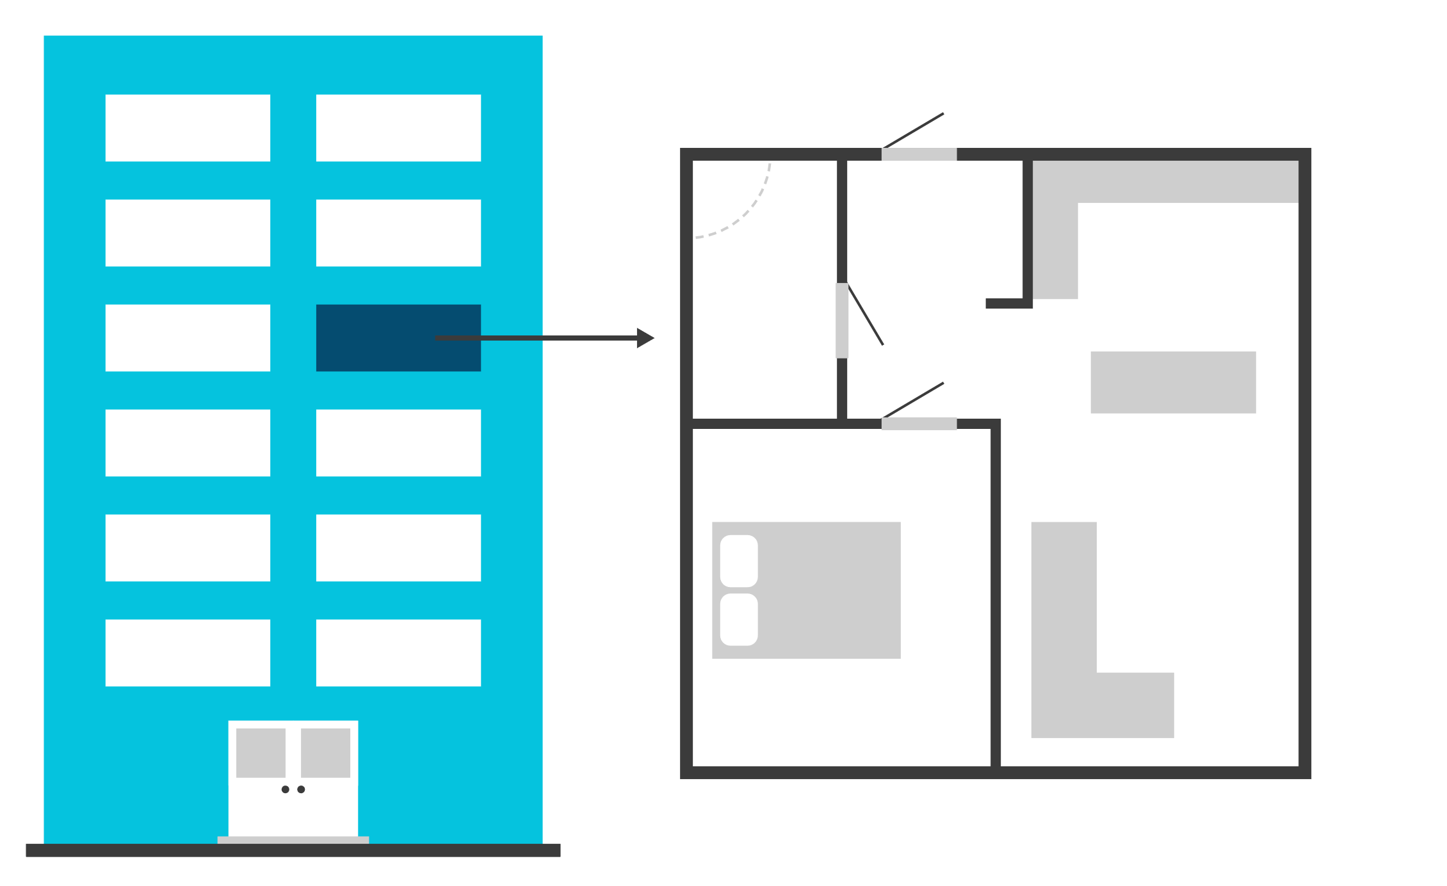
Spend Less
Same
Higher
Lower
Save less than 15%
Retire earlier than age 65
Notes:
[Optional]
The same applies if someone envisions a more modest lifestyle than they currently have. In that case, they could save less than 15% or retire earlier than age 65 . . . or be able to dedicate more money to charity or a legacy, or have more flexibility with their spending in the future (like taking one-time, fairly expensive trips).
Again, the point is that helping them know what their vision implies—without a full, detailed financial plan—provides them with an opportunity to personalize the standard rules of thumb to better align with their specific situation.

Slide 62
Visualize Retirement Framework
Retirement Vision
Personalized Action Plan
Retirement Income Preferences
Retirement Saving and Spending Plan
1. Standard Rules of Thumb
2. Personalized Rules of Thumb
Planning Preferences
Notes:
Here's where those Personalized Rules of Thumb fit in the framework—more customized to someone's situation than the Standard Rules of Thumb, drawing on their vision to do that personalization without too much additional effort.
[For DCIO Financial Professionals]
You can also use the Personalized Rules of Thumb approach for employees who may not have the money, time, or inclination for a full detailed plan.

Slide 63
Visualize Retirement Framework
Retirement Saving and Spending Plan
Detailed Financial Plan
Notes:
And, finally, there is always the option of creating a detailed financial plan—taking into account all the details of someone's situation and going through a deep analysis of their potential retirement spending and income needs, along with what that indicates for their savings actions.
This is a good time to reiterate that, even when creating a detailed financial plan for someone, the preferences gathered during the process—especially the Planning Preferences—can help with how the detailed plan might be communicated.
For example, if you're providing a Detailed Financial Plan to someone whose preference is to Avoid planning, you can 'soften' how you present it to make it more accessible—perhaps delivering the results in smaller pieces rather than all at once—and being explicit about connecting the financial solutions to the vision they've created.

Slide 64
Visualize Retirement Framework
Retirement Vision
Personalized Action Plan
Retirement Income Preferences
Retirement Saving and Spending Plan
1. Standard Rules of Thumb
2. Personalized Rules of Thumb
3. Detailed Financial Plan
Planning Preferences
Notes:
Again, this is what the Visualize Retirement Framework looks like as a whole. Modular, and designed to be connected to the work you're already doing. Pick and choose the components that are right for you—and for the particular preretiree you're serving.
Here's where all this takes us. Helping preretirees create their vision and understand their preferences lets them—and you—gain a deeper understanding of who they are as a person, what they want out of their retirement, and the road they're willing to take to get there.

Slide 65
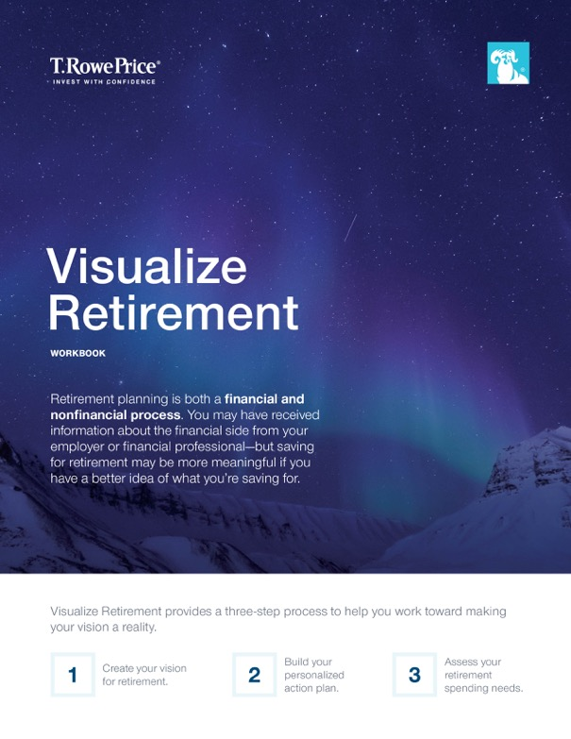
Visualize Retirement Workbook
Step 1: Create Vision
Step 2: Build Personalized Action Plan
Step 3: Assess Retirement Spending Needs
Notes:
[Optional]
To help preretirees, and you, accomplish all of this, we've created a variety of resources for each step in the process.
Since the core of the program is creating a retirement vision, we have a workbook that takes preretirees through the 5Ws I mentioned earlier.
It then walks them through the process of creating the Personalized Action Plan.
Third, they assess their retirement spending needs.

Slide 66
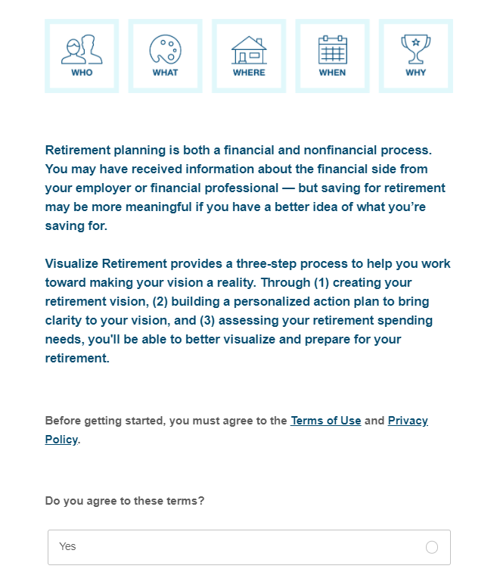
Visualize Retirement eWorkbook
Access to data insights
Provides reporting capabilities
Facilitates virtual engagements
Notes:
[Optional]
In addition to the printed version of the workbook, we have a digital version as well—the eWorkbook—which provides some important additional benefits.
We understand the need for data to help inform business processes and decisions. The eWorkbook provides access to this data. It not only captures the preretiree responses about their vision, but also feedback on the experience and additional topics they want to learn more about—valuable insights for you [and if you work with plan sponsors/employers, for them as well.]
We're then able to provide aggregated reporting, giving you a summary of usage as well as any feedback.
And lastly, the eWorkbook can help facilitate virtual engagements.

Slide 67
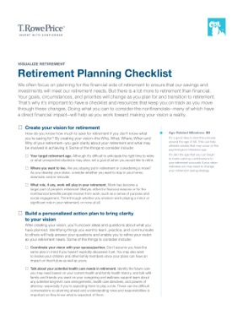
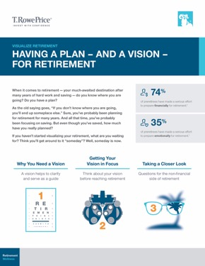
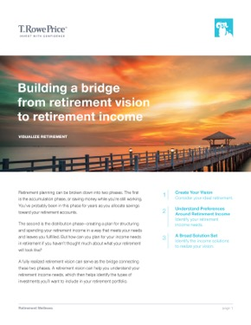
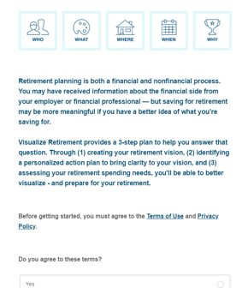
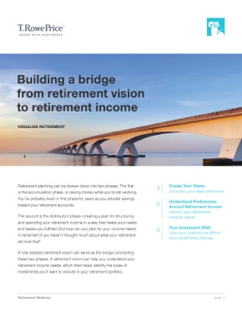
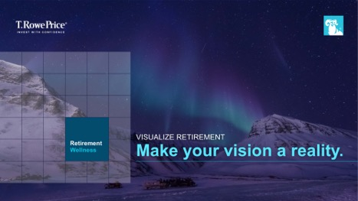
Resources for Preretirees
Building a Bridge From Retirement Vision to Retirement Income
Preretiree workshop (and Workbook/eWorkbook)
Nonfinancial
checklist
Conversation starters
Notes:
[Optional]
Beyond the workbook/eWorkbook, other resources for preretirees include:
Workshop:
A PowerPoint presentation, with content similar to this presentation, that also walks preretirees through the workbook/eWorkbook. Whether you deliver the presentation to a group of preretirees, present it to a couple sitting across the table, or just go through the it one-on-one, these tools provide you with a scalable framework you can use to help them create their vision and actionable next steps.
Checklist:
While there are a variety of checklists available that cover the financial aspects of preparing for retirement, it can be difficult to think about all of the nonfinancial details that someone needs to consider, so we've compiled a checklist for that. It includes things like:
Creating a vision (+ personalized action plan)
Defining a target retirement age
Talking with your family about your vision
Considering potential health care needs in retirement
Learning about Medicare and Social Security benefits
The checklist can be used to introduce the program to preretirees, or as a follow-up to the workbook/eWorkbook for additional next steps to help prepare for the nonfinancial aspects of retirement.
Conversation Starters:
Ongoing article series that allows you to stay in front of your clients with fresh, relevant insights.
Building a Bridge brochure:
Provides an overview on how a retirement vision can help preretirees understand their retirement income needs and the types of financial solutions they could consider for their retirement portfolios.

Slide 68
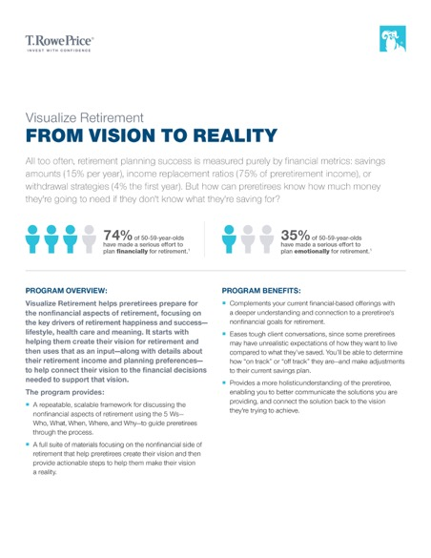
Additional Resources
Presentation
Program Guide
Notes:
[Optional]
Additional resources specific for financial professionals [as well as employer clients] include:
This presentation, which you can share with other members of your team, your practice, and your organization [as well as with your employer clients, if applicable].
Program guide—a 2-page summary of Visualize Retirement's key points, with a complete list of resources.
Access to all of these resources is available on the TRP website.
[For DCIO Financial Professionals]
If you use the eWorkbook with your employer clients, you will be able to share executive-summary level reporting on the usage, and any feedback, by their employees.

Slide 69
Summary
Why include nonfinancials
Financial and nonfinancial factors drive retirement happiness
Improves your understanding of and relationship with preretirees
What nonfinancials to include
Retirement vision
Retirement income and planning preferences
How to incorporate them
Identify preretirees who could benefit from this program
Use workbook; create Personal Action Plan and Retirement Saving and Spending plan
Notes:
Let's review what we've covered during our time together.
We started with why nonfinancials are so important. They are a key part of retirees' happiness and provide a more holistic view of what is important to preretirees.
Those nonfinancials include someone's retirement vision, as well as their preferences when it comes to retirement income and the planning process itself.
Using those inputs, a pretiree can build their Personal Action Plan and Retirement Saving and Spending plan. The latter ranging from Standard Rules of Thumb, to personalizing those rules of thumb based on what their vision indicates might happen to their lifestyle, to a detailed financial plan. And you can customize what you deliver and how you communicate it based on your own process and the needs of a particular preretiree.
In sum, our program puts you at the center of helping preretirees create their retirement vision, and move from vision to reality.

Slide 70
Important Information
This material is provided for general and educational purposes only, and not intended to provide legal, tax or investment advice. This material does not provide recommendations concerning investments, investment strategies or account types; and not intended to suggest any particular investment action is appropriate for you. Please consider your own circumstances before making an investment decision.
The material does not constitute a distribution, an offer, an invitation, a personal or general recommendation or solicitation to sell or buy any securities in any jurisdiction or to conduct any particular investment activity.
Information and opinions presented have been obtained or derived from sources believed to be reliable and current; however, we cannot guarantee the sources’ accuracy or completeness. There is no guarantee that any forecasts made will come to pass. The views contained herein are as of the date noted on the material and are subject to change without notice; these views may differ from those of other T. Rowe Price group companies and/or associates. Under no circumstances should the material, in whole or in part, be copied or redistributed without consent from T. Rowe Price.
Unless indicated otherwise the source of all market data is T. Rowe Price.
T. Rowe Price Investment Services, Inc.
© 2021 T. Rowe Price. All rights reserved. T. Rowe Price, INVEST WITH CONFIDENCE and the bighorn sheep design are, collectively and/or apart, trademarks or registered trademarks of T. Rowe Price Group, Inc.

Slide 71
CCON0077843 202102-1530345
3/21
Notes:
Thank you for your time, and confidence, in T. Rowe Price.

Slide 72
Cobranding Instructions
There are two alternate slides (73, 74) that need to be used in order to make this a cobranded presentation.
Title slide (slide 73)
Right click on slide 73 and uncheck “Hide Slide”
On slide 73, click the “Advisor Logo” space. A pop-up window will appear where you can select your logo file. Add your Name, Company Name and Date in the space provided.
Move slide 73 from the back of the presentation to slide position #1.
Delete the non-cobranded title slide (current slide 1).
Important Information slide (slide 74)
Right click on slide 74 and uncheck “Hide Slide”
On slide 74, replace “[XXXXXX]” with your Company Name.
Move slide 74 from the back of the presentation to the slide position before the “Thank You” slide (slide 71).
Delete the non-cobranded Important Information slide (current slide 70).

Slide 73
Place Advisor Logo Here
Presenter Name
Company Name
Date
Notes:
[For co-branding instructions, see Slide 73.]
[Note to Presenter:
Talking point copy in brackets are notes to you (as opposed to points to make about the content on the slide).
You may adapt the presentation to your audience and the time you have available in two ways:
1.Talking points specific to particular audience have [For Audience Name] as a header in the talking points.
2.Slides that are optional (based on audience or timing) have [Optional] at the top. For timing, you might consider skipping the following slides (listed in the order that you might consider leaving them out):
TBD
-----------------------------------------
Today we’re going to talk about preretirees and the transition to retirement.
As an industry, we’ve been so focused on outlining financial and income needs related to retirement, that sometimes we forget that behind the numbers is someone’s retirement life. And that is the most important thing to that individual.

Slide 74
Important Information
T. Rowe Price Investment Services, Inc. and [XXXXXX] are not affiliated.
This material is provided for general and educational purposes only, and not intended to provide legal, tax or investment advice. This material does not provide recommendations concerning investments, investment strategies or account types; and not intended to suggest any particular investment action is appropriate for you. Please consider your own circumstances before making an investment decision.
The material does not constitute a distribution, an offer, an invitation, a personal or general recommendation or solicitation to sell or buy any securities in any jurisdiction or to conduct any particular investment activity.
Information and opinions presented have been obtained or derived from sources believed to be reliable and current; however, we cannot guarantee the sources’ accuracy or completeness. There is no guarantee that any forecasts made will come to pass. The views contained herein are as of the date noted on the material and are subject to change without notice; these views may differ from those of other T. Rowe Price group companies and/or associates. Under no circumstances should the material, in whole or in part, be copied or redistributed without consent from T. Rowe Price.
Unless indicated otherwise the source of all market data is T. Rowe Price.
T. Rowe Price Investment Services, Inc.
© 2021 T. Rowe Price. All rights reserved. T. Rowe Price, INVEST WITH CONFIDENCE and the bighorn sheep design are, collectively and/or apart, trademarks or registered trademarks of T. Rowe Price Group, Inc.

